Slide 1

Distributed Deep Learning

Slide 2

HBv3
Azure HBv3 VM Sizes
VM Size | 120 CPU cores | 96 CPU cores | 64 CPU cores | 32 CPU cores | 16 CPU cores
VM Name | standard_HB120rs_v3 | standard_HB120-96rs_v3 | standard_HB120-64rs_v3 | standard_HB120-32rs_v3 | standard_HB120-16rs_v3
InfiniBand | 200 Gb/s HDR | 200 Gb | 200 Gb | 200 Gb | 200 Gb
Peak CPU Frequency* | 3.5 GHz | 3.675 GHz | 3.675 GHz | 3.675 GHz | 3.675 GHz
RAM per VM | 448 GB | 448 GB | 448 GB | 448 GB | 448 GB
RAM per core | 3.75 GB | 4.67 GB | 7 GB | 14 GB | 28 GB
Memory B/W per VM | 350 GB/s | 350 GB/s | 350 GB/s | 350 GB/s | 350 GB/s
Memory B/W per core | 2.91 GB/s | 3.65 GB/s | 5.46 GB/s | 10.9 GB/s | 21.9 GB/s
L3 Cache per VM | 1.5 GB | 480 MB | 480 MB | 480 MB | 480 MB
L3 Cache per core | 12.8 MB | 16 MB | 24 MB | 48 MB | 96 MB
SSD Perf per VM | 2 * 960 GB NVMe – 6.9 GB/s (Read) / 2.9 GB/s (Write), 200k IOPS (Read) / 190k IOPS (Write)
Highest Perf per VM
Highest Perf per Core
*Clock frequencies are based on non-AVX workload scenarios and are based on measured frequency delivery for workloads as captured by the Azure HPC team with AMD EPYC 7003-series processors and corresponding system firmware as of January 2021. Experienced clock frequency by a customer is a function of a variety of factors, including the coding and usage of a given application. Frequencies indicated above are not necessarily indicative of final clock frequencies for EPYC 7003-series processors.
Notes:
Jennifer

Slide 3


GPUs for Compute (NC) & Visualization (NV)
Azure Instance → | NC | NCv2 | NCv3 | NCasT4_v3 | NC A100 v4
Cores | 6, 12, 24 | 6, 12, 24 | 6, 12, 24 | 4, 8, 16, 64 | 24, 48, 96
GPU | Tesla K80 | Tesla P100 | Tesla V100 | Tesla T4 | A100 Tensor Core
Memory | 56/112/224 GB | 112/224/448 GB | 112/224/448 GB | 28/56/110/440 GB | 220/440/880 GB
Local Disk | 340/680/1440 GB SSD | 736/1474/2948 GB SSD | 736/1474/2948 GB SSD | 180/360/2880 GB SSD | 1123/2246/4492 GB
Network | Azure Network + InfiniBand (largest size only)
compute
Azure Instance → | NV | NVv3 | NVv4 | NVads A10 v5
Cores | 6, 12, 24 | 12, 24, 48 | 4, 8, 16, 32 | 6, 12, 18, 36, 72
GPU | Tesla M60 | Tesla M60 | Radeon Instinct MI25 | A10 Tensor Core
Memory | 56,112,224 GB | 112/224/448 GB | 14/28/56/112 GB | 55/110/220/440/880 GB
Local Disk | 340/680/1440 TB SSD | 320/640/1280 GB SSD | 88/176/352/704 GB | 180/320/720/1400 GB
Network | Azure Network
visualize
Notes:
Esthela
NC Series are set to retire September 6, 2023
NC v2 are set to retire September 6, 2023
NV are set to retire September 6, 2023

Slide 4
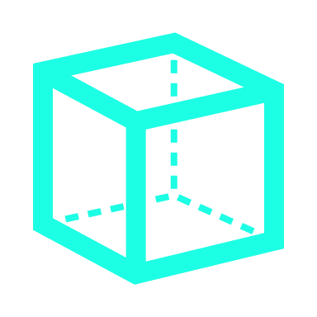
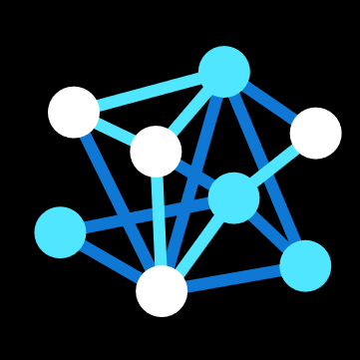
GPUs for Deep Learning (ND Series)
CPU Cores | 6,12,24 | 40 | 96 | 96
GPU | 1x, 2x, or 4x P40 GPUs | 8x V100 32 GB (NVLink) GPUs | 8x A100 40 GB GPUs | 8x A100 80 GB GPUs
Memory | 12/224/448 GB | 672 GB | 900 GB | 1900 GB
Local Disk | 736/1474/2948 GiB SSD | 2948 GiB SSD | 6 TB SSD | 6.4 TB SSD
Network | Azure Network + InfiniBand EDR | Azure Network + InfiniBand EDR + NVLink GPU Interconnect | Azure Network + InfiniBand EDR + NVLink GPU Interconnect | Azure Network + InfiniBand EDR + NVLink GPU Interconnect
ND
NDv2
ND A100 v4
NDm A100 v4
deep learning
Notes:
Esthela

Slide 5

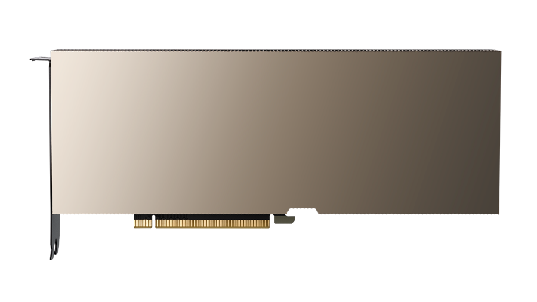

Azure NC A100 v4 Virtual Machine
Applied AI Inferencing Platform
Build & train innovative models
Perfect for real-world Azure Applied AI training and batch inference workloads such as:
GPU-accelerated analytics and databases
Batch inferencing with heavy pre- and post-processing
Autonomous driving reinforcement learning
Oil and gas reservoir simulation
Machine learning (ML) development
Video processing
AI/ML web services
Best of both CPU and GPU resources
NVIDIA A100 PCIe GPU and 3rd-generation AMD Epyc™ 7V13 (Milan) processors
Up to four (4) NVIDIA A100 PCIe GPUs with 80GB memory each for each VM
Up to 96 non-multithreaded AMD EPYC Milan processor cores and 880 GiB of system memory
Supported with Ubuntu 18.04, 20.04 CentOS 7.9, CentOS 8.4, RHEL 7.9 and RHEL 8.5 images
Powered by:
NVIDIA A100 GPU
VM Instance | vCPU | Memory: GiB | Temp Storage (with NVMe) : GiB | GPU | GPU Memory: GiB | Max data disks | Max uncached disk throughput: IOPS / MBps | Max NICs/network bandwidth (Mbps)
Standard_NC24ads_A100_v4 | 24 | 220 | 1123 | 1 | 80 | 12 | 30000/1000 | 2/20,000
Standard_NC48ads_A100_v4 | 48 | 440 | 2246 | 2 | 160 | 24 | 60000/2000 | 4/40,000
Standard_NC96ads_A100_v4 | 96 | 880 | 4492 | 4 | 320 | 32 | 120000/4000 | 8/80,0
Notes:
Esthela

Slide 6
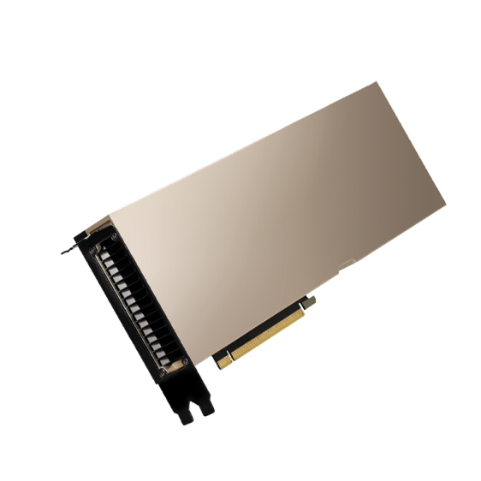







Azure NDm A100 v4 Virtual Machine
Deep learning & tightly coupled workload platform
A scaling powerhouse
Perfect for accelerating your time to outcome using industry-standard frameworks
Fast processing w/higher memory
8 x NVIDIA Ampere A100 80GB Tensor Core GPUs designed for high-end Deep Learning training and tightly-coupled scale-up and scale-out HPC workloads.
Each GPU with own dedicated, topology-agnostic 200 Gb/s NVIDIA Mellanox HDR InfiniBand connection
Network connections are automatically configured within the same VM Scale Set
Supports standardized analytic tools for GPU acceleration 'out-of-the-box,' such as TensorFlow, Pytorch, Caffe, and RAPIDS
Powered by:
NVIDIA A100 80GB GPU
Size | vCPU | Memory: GiB | Temp Storage (SSD): GiB | GPU | GPU Memory: GiB | Max data disks | Max un-cached disk throughput: IOPS / MBps | Max network bandwidth | Max NICs
Standard_ND96amsr_A100_v4 | 96 | 1900 | 6400 | 8 x A100 80 GB GPUs (NVLink 3.0) | 80 | 32 | 80,000 / 800 | 24,000 Mbps | 8
2021
#1
2021
highest performing cloud provider in the world
10
Ranking #10 in the #Top500 Supercomputing list
#
on
#2
highest performing supercomputer in the world
Notes:
Esthela

Slide 7
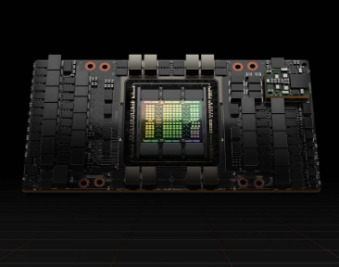
Azure ND H100 v5 Virtual Machine
Deep learning & tightly coupled workload platform
A scaling powerhouse
Perfect for accelerating your time to outcome using industry-standard frameworks
Fast processing w/higher memory
8 x NVIDIA H100 80GB Tensor Core GPUs designed for high-end Deep Learning training and tightly-coupled scale-up and scale-out Generative AI and HPC workloads.
Each GPU with own dedicated, topology-agnostic 400 Gb/s NVIDIA Quantum-2 CX7 InfiniBand connection
Network connections are automatically configured within the same VM Scale Set
Supports standardized analytic tools for GPU acceleration 'out-of-the-box,' such as TensorFlow, Pytorch, Caffe, and RAPIDS
Size | vCPU | Memory: GiB | Temp Storage (SSD): GiB | GPU | GPU Memory: GiB | Max data disks | Max un-cached disk throughput: IOPS / MBps | Max network bandwidth | Max NICs
Standard_ND96is_v5 | 96 | 1900 | 1000 | 8 x H100 80 GB GPUs (NVLink 4.0) | 80 | 32 | 40800/612 | 24000 Mbps | 8
Notes:
Esthela

Slide 8
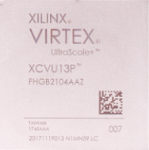
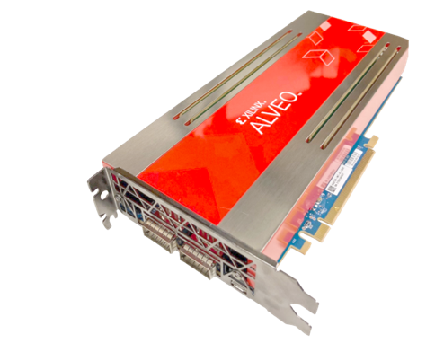
Azure NP Series w/FPGA Runtime
Best-in-class PR shell, 80%+ device available to user
API for automatic signing of designs on-the-fly
64 GB of DDR4 2400 (4 banks) per accelerator
HPC application workloads:
Genomics & Life Sciences
Computational Chemistry
Physical Simulation
Transcoding & Postprocessing
Analytics & Databases
Monte Carlo & Risk Analysis
Standards-based platform
SDaccel shell and runtime
Alveo U250 board
RTL, HLS (C++), or mixed-language
DMA I/O to host via PCIe G3 x16
Host VM Specifications | NP10 | NP20 | NP30
Physical Cores (Intel Skylake) | 10 | 20 | 40
NVMe SSD Storage | 1.5 TB | 3 TB | 6 TB
RAM | 192 GB | 384 GB | 768 GB
Accelerators (U250s) | 1 | 2 | 4
Notes:
Esthela

Slide 9
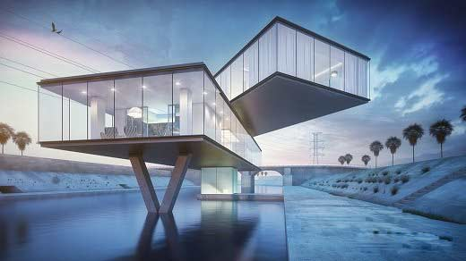

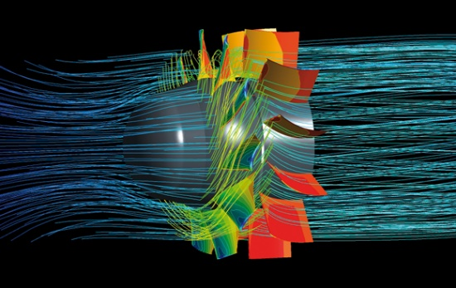
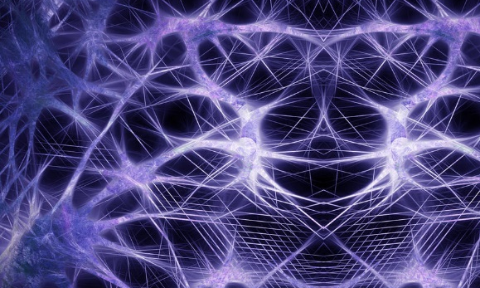
GPU Computing
Visualization
Rendering
HPC/Simulation
Deep-Learning/AI
NV
NC
ND
Workload centric PCs & Workstations
Variable configuration for GPU workstations for content consumption
Modern workspace for interactive collaboration
Scale out using IB for multimode HPC and ML workloads on any MPI stack
Scale-up multi-GPU VMs with fast NVLINK interconnect for high-density single box training and HPC workloads

Slide 10
GPUs for Compute (NC) & Visualization (NV)
Azure Instance → | NC | NCv2 | NCv3 | NCasT4_v3 | NC A100 v4
Cores | 6, 12, 24 | 6, 12, 24 | 6, 12, 24 | 4, 8, 16, 64 | 24, 48, 96
GPU | Tesla K80 | Tesla P100 | Tesla V100 | Tesla T4 | A100 Tensor Core
Memory | 56/112/224 GB | 112/224/448 GB | 112/224/448 GB | 28/56/110/440 GB | 220/440/880 GB
Local Disk | 340/680/1440 GB SSD | 736/1474/2948 GB SSD | 736/1474/2948 GB SSD | 180/360/2880 GB SSD | 1123/2246/4492 GB
Network | Azure Network + InfiniBand (largest size only)
compute
Azure Instance → | NV | NVv3 | NVv4 | NVads A10 v5
Cores | 6, 12, 24 | 12, 24, 48 | 4, 8, 16, 32 | 6, 12, 18, 36, 72
GPU | Tesla M60 | Tesla M60 | Radeon Instinct MI25 | A10 Tensor Core
Memory | 56,112,224 GB | 112/224/448 GB | 14/28/56/112 GB | 55/110/220/440/880 GB
Local Disk | 340/680/1440 TB SSD | 320/640/1280 GB SSD | 88/176/352/704 GB | 180/320/720/1400 GB
Network | Azure Network
visualize

Slide 11
GPUs for Deep Learning (ND series)
Azure instance → | ND | NDv2 | ND A100 v4 | NDm A100 v4
CPU Cores | 6,12,24 | 40 | 96 | 96
GPU | 1x, 2x, or 4x P40 GPUs | 8x V100 32 GB (NVLink) GPUs | 8x A100 40 GB GPUs | 8x A100 80 GB GPUs
Memory | 12/224/448 GB | 672 GB | 900 GB | 1900 GB
Local Disk | 736/1474/2948 GiB SSD | 2948 GiB SSD | 6 TB SSD | 6.4 TB SSD
Network | Azure Network + InfiniBand EDR | Azure Network + InfiniBand EDR + NVLink GPU Interconnect | Azure Network + InfiniBand EDR + NVLink GPU Interconnect | Azure Network + InfiniBand EDR + NVLink GPU Interconnect
deep learning

Slide 12
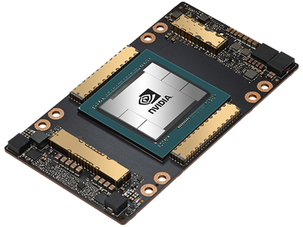
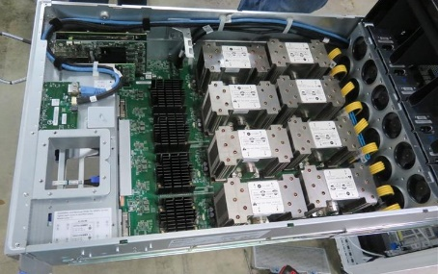
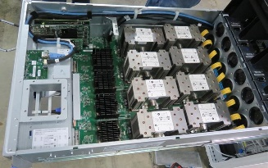
Building Scalable Supercomputers in the Cloud
Single A100 GPU
Multi-GPU VM
NVLINK™
A100 x 8
Multi-GPU VMs
InfiniBand™
A100 x n
NCCL+ NVLink
NCCL+ HDR
Notes:
Pairs of NVIDIA Ampere A100 Tensor Core GPUs are interconnected at 600 GB/s via the NVIDIA NVLINK Bridge
Pairs of GPUs are interconnected via NVIDIA NVswitch (based upon the 64GB/s PCIe Gen4 interconnect)
NVIDIA NCCL provides the software primitives required to make optimal use of this fabric
Mellanox InfiniBand HDR is used as the interconnect fabric
For additional details regarding the Azure ND A100 v4 series VMs see the documentation at https://docs.microsoft.com/en-us/azure/virtual-machines/nda100-v4-series; NVIDIA Ampere A100 Tensor Core GPUs are detailed at https://www.nvidia.com/en-in/data-center/a100/.

Slide 13
ND_v4 Node Topology
CPU 0
Total InfiniBand BW
1.6Tb/s = 8 x 200Gb/s
CPU 1
ib0
ib2
ib0
ib2
PCIe switch
PCIe switch
PCIe switch
PCIe switch
ib1
ib3
ib1
ib3
GPU 0
GPU 1
GPU 0
GPU 1
GPU 0
GPU 1
GPU 0
GPU 1
300Gb/s
300Gb/s
300Gb/s
NVSwitch
300Gb/s
300Gb/s
300Gb/s
300Gb/s
300Gb/s
NVLink3 connectivity
Notes:
Source https://techcommunity.microsoft.com/t5/azure-global/performance-considerations-for-large-scale-deep-learning/ba-p/2693834

Slide 14
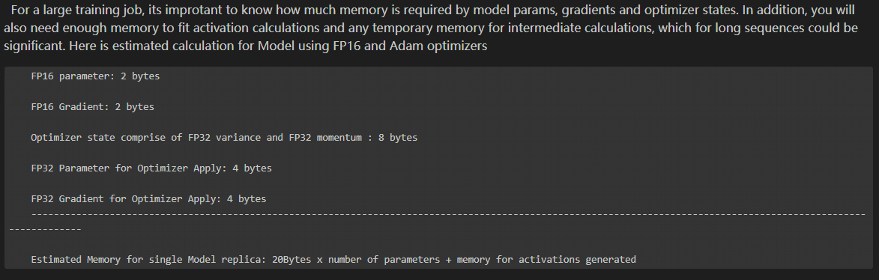
Optimizer required memory

Slide 15
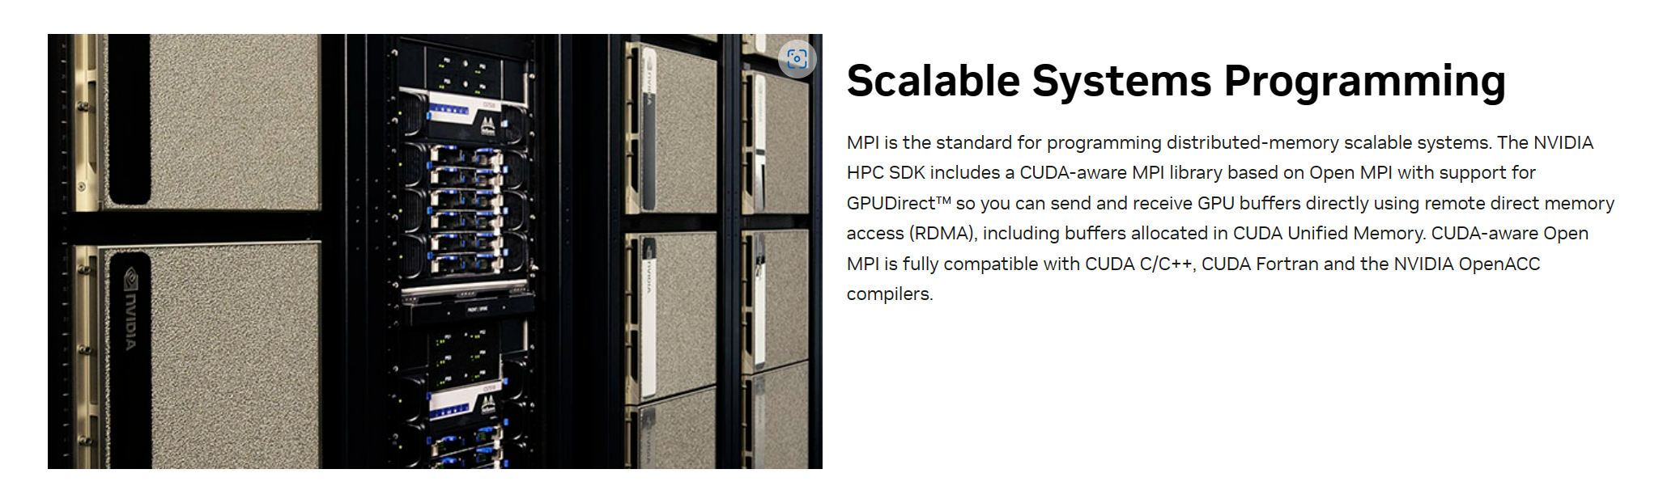

Slide 16

Collective operation - Wikipedia
Collective operations serve as fundamental elements for interaction patterns, commonly utilized in Single Program, Multiple Data (SPMD) algorithms within the parallel programming sphere. They are critical for efficient communication and data exchange among multiple processes in a parallel computing environment. One key implementation of collective operations is found in the Message Passing Interface (MPI) which facilitates these operations across different processes​1​.

